Slide 1
Minimum Spanning Tree Algorithms
DATA STRUCTURES & ALGORITHMS
B
5
4
D
A
1
8
2
Optimal edge-weight minimisation on connected undirected graphs, via Prim's cut-property growth and Kruskal's forest-merging strategy.
2
C
10
E
Prim's · Vertex growth
Kruskal's · Edge union
MST_COST
PRESENTER
PRN
SECTION
AI TOOL USED
10
Nidhhi Khobragade
25070521293
E2
Claude
|V| = 5 · |E| = 7 · 4 edges chosen
Notes:
Welcome. Today: two classic greedy algorithms that find the cheapest way to connect every vertex of a weighted graph: Prim and Kruskal. The graph on the right previews the answer: the gold edges are the minimum spanning tree, total cost 10.

Slide 2
What is a minimum spanning tree?
01 · GRAPH THEORY · CORE DEFINITION
A connected, undirected, weighted graph G = (V, E) admits a spanning tree that covers all |V| vertices at minimal total cost.
FIGURE 1 · G(V, E)
MST edge
Discarded
B
|V| − 1
Spanning & acyclic
5
Connects every vertex using exactly |V| − 1 edges, with strictly no cycles.
4
D
A
Σ w(e)
Minimal weight
1
Minimises the aggregate cost w(T) = Σ w(e) over all possible spanning trees.
8
2
2
Greedy
Greedy choice property
C
E
10
Locally optimal edge selections yield a globally optimal tree, via cut and cycle invariants.
|V| = 5 |E| = 7 MST weight = 1 + 2 + 2 + 5 = 10
Scope: undirected · connected · weighted real edges
Notes:
Five cities, seven candidate roads. A spanning tree uses exactly V minus 1 edges with no cycles; the minimum one has the lowest total weight. Greedy choices work because of the cut and cycle properties. The gold edges are the answer: total cost 10.

Slide 3
Kruskal's: sort, check, merge
02 · ALGORITHM 02 · EDGE-CENTRIC STRATEGY
1
INITIALIZE
2
EVALUATE
B
5
Sort all edges
Inspect the lightest
4
D
Sort edges by non-decreasing weight; each vertex starts in its own set.
Take the lightest edge (u, v) and query the DSU roots of both ends.
A
1
8
2
sort(edges, key=weight)
make_set(v) for v in V
root_u = find(u)
root_v = find(v)
2
C
10
E
3
VALIDATE
4
TERMINATE
Cycle check & union
Discard or complete
B–C · 1
A–C · 2
D–E · 2
Different roots mean separate trees, so connect them without a cycle.
Cycle-forming edges are dropped; halt at exactly V − 1 valid edges.
A–B · 4
B–D · 5
C–D · 8
C–E · 10
if root_u != root_v:
union(u, v); MST.add(e)
if len(MST) == V - 1:
return MST # Complete
A–B closes the cycle A–C–B, so it is skipped. C–D and C–E are never needed.
Stop at V − 1 = 4 edges · total = 1 + 2 + 2 + 5 = 10
O(E log E)
DSU: O(α(V))
Notes:
Four steps: sort, inspect the lightest edge, check roots in the disjoint-set union, then discard or finish. On our graph B–C, A–C and D–E go in; A–B would close a cycle through C; B–D joins the two groups; four edges means V minus 1, so we stop at weight 10. Complexity O(E log E), with near-constant-time DSU checks thanks to path compression and rank. Strategy: global sort; structure: disjoint sets. Best on sparse graphs where edges are few relative to V squared.

Slide 4
Prim's: grow one tree outward
03 · GREEDY PARADIGM · VERTEX-DRIVEN MST
B
PHASE 01
ROOT
PHASE 02
EVALUATE
5
Initialize tree
Inspect the cut
4
D
A
Select an arbitrary source vertex to seed tree set S. All other vertices remain in the unexplored set V \ S.
Track all frontier edges crossing the cut between S and the outside, kept in a min-heap priority queue.
1
8
2
2
C
10
E
PHASE 03
SELECT
PHASE 04
EXPAND
Greedy extraction
Absorb vertex
Start · A
1 · A–C (2)
2 · B–C (1)
Extract the minimum-weight frontier edge. The safe-edge property keeps the connection acyclic.
Absorb the target into S and decrease keys of adjacent neighbours until all |V| vertices are spanned.
3 · B–D (5)
4 · D–E (2)
Total · 10
Each step takes the cheapest edge leaving the tree. It lands on the same tree as Kruskal.
while queue ≠ ∅: extractMin(); decreaseKey()
O((V + E) log V) · binary heap
Fibonacci heap: O(E + V log V)
Notes:
Prim starts from any vertex. At each step it inspects all edges crossing the cut between the tree and everything else and takes the cheapest one; a min-heap makes that fast and decreaseKey updates neighbours. Running complexity is O((V + E) log V) with a binary heap and drops to O(E + V log V) with Fibonacci heaps. It dominates on dense graphs (E close to V squared) because the vertex checks scale predictably.

Slide 5
Prim's vs Kruskal's: pick your tool
04 · COMPARATIVE SYNTHESIS
PRIM'S · VERTEX-ORIENTED
KRUSKAL'S · EDGE-ORIENTED
Grows a single connected tree continuously, vertex by vertex, from a start node.
CORE INVARIANT
Merges a disconnected forest of trees edge by edge, in ascending weight order.
Dense graphs: efficient when the edge count approaches E ≈ V².
OPTIMAL TOPOLOGY
Sparse graphs: highly effective when the edge count stays near E ≈ V.
Priority queue (min-heap / Fibonacci heap) keyed on lowest cut weights.
KEY STRUCTURE
Disjoint set union (Union-Find) with path compression and rank heuristics.
Implicit: only inspects edges crossing into unvisited vertices.
CYCLE PREVENTION
Explicit: checks whether endpoints share a representative, Find(u) == Find(v).
Best when adjacency matrices exist or density is high.
Best when edges are already sorted or kept as edge lists.
DECISION RULE If E ≈ V² choose Prim. If E ≈ V, or edges are pre-sorted, choose Kruskal.
Notes:
Prim is vertex-oriented and grows one tree; Kruskal is edge-oriented and merges a forest. Dense graphs or adjacency matrices favour Prim. Sparse graphs or pre-sorted edge lists favour Kruskal. Cycle prevention is implicit in Prim and explicit via Find in Kruskal.

Slide 6
Complexity analysis
05 · ALGORITHM BENCHMARK · ASYMPTOTIC EFFICIENCY
ALGORITHM | DATA STRUCTURE | TIME COMPLEXITY | OPTIMAL FOR
Prim's | Adjacency matrix + array | O(V²) | Dense graphs (E ≈ V²)
Prim's | Binary heap + adjacency list | O(E log V) | Sparse graphs
Kruskal's | Edge-list sorting (standard) | O(E log E) | Sparse graphs
Kruskal's | Union-Find / DSU (inverse Ackermann) | O(α(V)) per op | Cycle checking
DENSE CHAMPION
DSU OPERATION BOUND O(α(V))
The adjacency matrix avoids priority-queue overhead when the edge count approaches its maximum (E ≈ V²).
The inverse Ackermann function grows so slowly that DSU checks run in virtually constant time for every practical V.
Notes:
Prim with an adjacency matrix runs in V squared, ideal for dense graphs. With a binary heap it is E log V. Kruskal is dominated by sorting, E log E, and its cycle checks are almost constant time thanks to union-find.

Slide 7
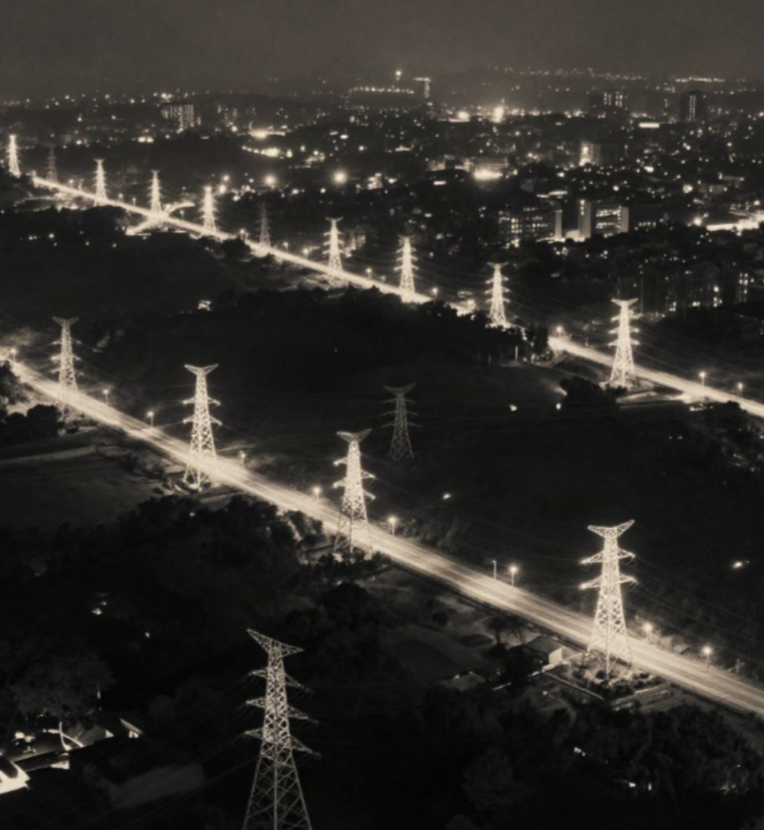




Applications & takeaways
06 · PRODUCTION SYSTEMS · MST DEPLOYMENT
Network design
LAN topologies, telecom trunks and fibre backbones at minimum installation cost.
Transportation systems
Highway, rail and airline route planning that connects every city with the least asphalt and track.
Machine learning & clustering
Single-linkage clustering removes the k − 1 heaviest MST edges to yield k natural clusters.
Image processing
Graph-based segmentation and edge extraction treat adjacent pixel gradients as weighted edges.
DIFFERENT PATHS, ONE CHEAPEST NETWORK
Kruskal's sorts edges and merges a forest.
Prim's grows one tree from a root.
Both are greedy and optimal: cost 10.
Notes:
Anywhere the goal is 'connect everything as cheaply as possible' you will find an MST: network design, transportation, clustering in machine learning, image segmentation. To close: Kruskal sorts edges and merges a forest, Prim grows one tree, both are greedy and optimal. Thank you.

